Slide 1






Rajeswari vedhachalam
Govt Arts College Chengalpattu
PG department of computer Science
Guided By DR.T.vani
Intelligent Admission
TEAM MEMBERS
R.Asath
S.Janarthhanam
A.Jayakanthan
V.Yoganathan
Future of University
Descision Making

Slide 2





01
Description
The aim of this project is to help students in short listing universities with their profiles. Machine learning algorithms are then used to train a model on this data, which can be used to predict thechances of futureapplicants being admitted.

Slide 3
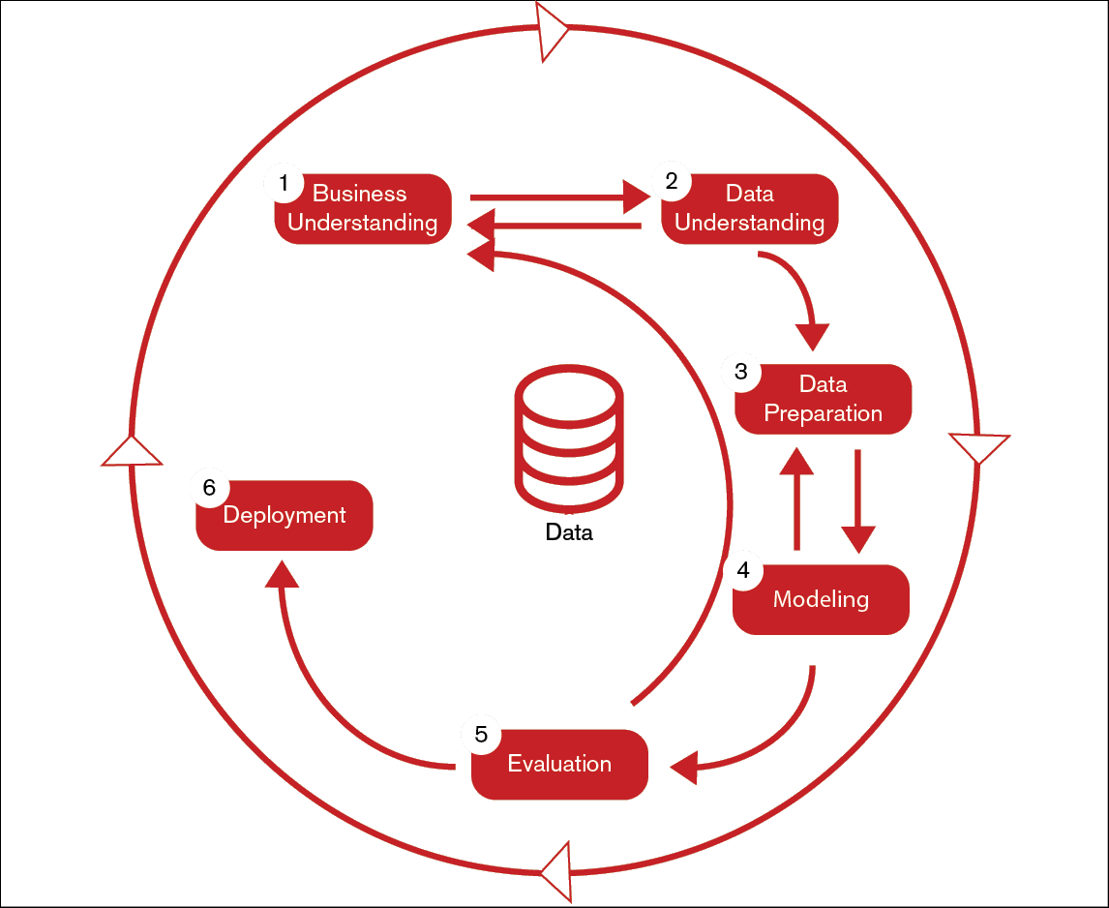
Challenges Faced By University Admissions
02
Large Volume Of Applications
Subjectivity In Decision-making
Limited Resources and time
Difficulty in Predicting Applicant Success
Lack of Diversity And Bias

Slide 4
Project Flow
01
Define problem
Literature Survey
Social / business impact
04
Model Buliding
Training the model in Multiple Algorithms
Testing the Model
03
Performance Testing & Tuning
Testing Model With Multiple Evluation Metrics
Comparing Model Accuracy Before & after
Applying Tuning
02
Data Collection & preparation
Collect the Dataset
Data Preparation
05
06
Model Deployment
Save the Best Model
03
Exploratory Data Analysis
Visual Analysis
Descriptive Statstical

Slide 5

Data Collection & Preparation
Discuss the significance of data collection and preparation in the graduate
Admission process and its impact on the accuracy of machine learning models
Import Various Libraries
It helps to refer the code function or object that are on another file
50
Prepare Dataset For ML
Steps To Prepare The Data.
Get The Dataset.
Handle Missing Data.
Encode Categorical data.
Split the dataset into
Training Set and Test Set.
Feature Scaling
40
04
30
20
10
0
130
120
115
100
95

Slide 6
Exploratory
Data Analysis
INPUT
GRE scores (out of 340)
TOEFL Scores (out of 120)
University rating (out of 5)
Undergraduate GPA (out of 10)
Statement of purpose( SOP)
Letter of Recommendation (LOR) strength (out of 5)
Research experience (either 0 or 1)
Exploratory Data Analysis (EDA) is an analysis approach that identifies general patterns in the data.
These patterns include outliers and features of the data that might be unexpected. EDA is an important first step in any data analysis
05
The four types of EDA are univariate non-graphical, multivariate non- graphical, univariate graphical, and multivariate graphical.
Exploratory analysis is the process of turning over 100 rocks to find perhaps 1 or 2 precious gemstones

Slide 7
Model
Building
Model Building
Choose a suitable algorithm
Building an ML Model requires splitting of data into two sets, such as 'training set' and 'testing set' in the ratio of 80:20 or 70:30
A LogisticRegression algorithm is initialised and training data is passed to the model with the
.fit() function. Test data is predicted with .predict() function and saved in a new variable. For evaluating the model, a confusion matrix and classification report is done.
06
Model Testing
Check the accuracy
Applying the Model
Make the required changes after testing and fix the model

Slide 8
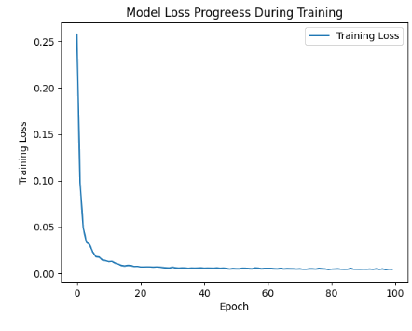
Performance Testing &
Hyper Tuning
Model deployment is the process of implementing a fully
functioning machine learning model into production where
it can make predictions based on data. Users, developers,
and systemsthen use thesepredictions to make practical business
Decisions
HyperTuning
that are used by learning algorithms
Hyperparameters are defined as the parameters that are
explicitly defined by the user to control the learning process.
these are external to the model, and their values cannot be changed during the training process.
07

Slide 9
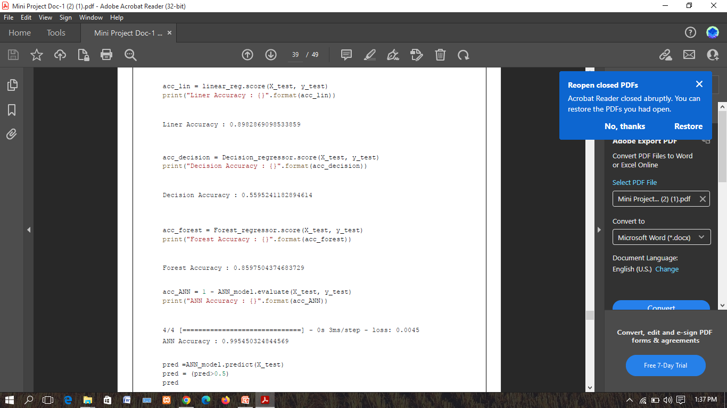
CHECKING SCORE THE REGRESSORS

Slide 10
Model
Deployment
125
100
the process of implementing a fully functioning
model it can make predictions based on data.
these predictions to make practical business descisions
Save The Best Model
To deploy a machine learning application, you first need
to build your model.
Optimize and test code, then clean and test again.
Prepare for container deployment.
Plan for continuous monitoring and maintenance
75
08
50
25
0
2018
2019
2020
2021
2022

Slide 11


STUDIO SHODWE
THANK YOU

